Slide 1
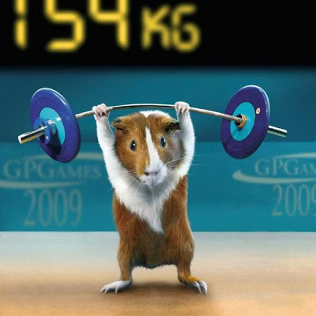
Practice

Slide 2
Processes from a user perspective
2
Practice for the final

Slide 3
What command do I use in a script to catch a signal?
trap
Using trap, I can catch any signal and avoid having the program closed because of it. True or False?
False
What can’t be trapped?
SIGKILL and SIGSTOP
Using the command kill serves to kill any program.
False – it’s to send a signal. Some can be ‘deadly’ but they don’t have to.
3
Practice for the final

Slide 4
How can I detach a process so it doesn’t read the shell input?
&
How can I detach a process so it doesn’t read input or doesn’t display output?
nohup
How do you use crontab?
Use crontab –e to edit the control file, where each line goes as:
Minute Hour Day Month Weekday Command
What’s batch for?
Run a process when the load is low.
4
Practice for the final

Slide 5
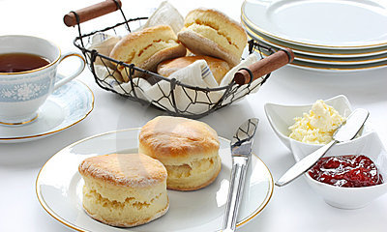
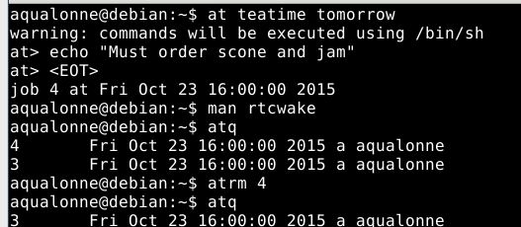
John is trying to cut on his British diet for the week. On Monday, at tea time, the computer should show tell him "you're allowed 5 cups of tea". The next day, same time, he would be allowed 4 cups; then 3 cups the next day, etc. When he can't drink tea, the computer shows the message "No tea today". Write a script diet.sh that schedules all these messages to be displayed.
now + 5 minutes
5
Practice for the final

Slide 6

Ctrl+C is a SIGINT, 2
Write a script ghost.sh. When the user closes the script (using Ctrl+C), the script closes but the user will see the message "I am still in your Shell" in the shell 5, 10, and 15 minutes later.
In words (don't write a script!), clearly explain how to get rid of such a "ghost in the shell".
6
Practice for the final

Slide 7
John is a system administrator. He works remotely and charges by the hour. The customer doesn't understand John's job. So John takes a few minutes to write a file named jobToDo, containing all the lines that he'd normally have to enter in the Shell for his job. Then, he writes a script doMyJob.sh that schedules all the lines to be run, waiting for 5 minutes between each line. So for example, the first line runs now, 5 mins later the next line will run, etc. John wants to start the script and go play at the Casino while charging the customer for 5 hours worth of work.
Write the script doMyJob.sh to help John enjoy life. To run a line, give it as argument to exec.
7
Practice for the final

Slide 8
Functions
8
Practice for the final

Slide 9
What is this: :(){ :|: & };:
It’s a fork bomb, it creates processes again and again. It’s bad!
If you want to write an empty function that fits on a single line, what should be inside?
:;
Write a one line function in a script to redefine rm so that it does rm -i
rm () { command rm - i; }
What do we use ‘return’ for?
To send error codes from a function. Never actual results.
9
Practice for the final

Slide 10
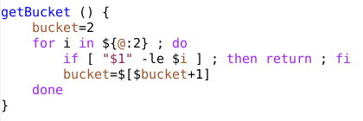
Explain the following function.
What do we use local for?
Variables used only within a function and that should not pollute the space of the whole script, such as loop indexes.
In a function, what does $0 correspond to?
The name of the script. Not the name of the function.
In a function, what does $1 correspond to?
The first argument given to the function.
10
Practice for the final

Slide 11
Write a function named isInList which takes as arguments a number followed by a set of at least one other number. It shows ‘true’ if the number is in the list and ‘false’ otherwise.
Write a function named weightedSum. It can take any number of arguments but they are expected to come in pairs a1 b1 a2 b2 ... an bn. It computes the weighted sum a1*b1 + a2*b2 + ... + an*bn. For example, if we wrote
weightedSum 2 5 3 1 4 5
we would get 33 because 2*5+3*1+4*5=33.
Write a function named anythingElse which takes as arguments a set of numbers. It returns any number that is not in this set.
11
Practice for the final

Slide 12
Text processing
12
Practice for the final

Slide 13
What’s the difference between a glob and a regex?
When do you use sed compared to grep?
What are back references?
13
Practice for the final

Slide 14
Associate each pattern with what it represents.
\<
^
[^ ]
$
*
.
End of line
Any one character
Beginning of line
Beginning of a word
Negating
Any amount of the previous character
14
Practice for the final

Slide 15
For his nutrition class, Joe keeps one week of food diary (Monday til Sunday) on this format:
Monday Breakfast Chicken omelette with extra chicken
Monday Lunch Chicken salad
Monday Dinner Chicken waffle
Tuesday Breakfast Pain au chocolat
Tuesday Lunch Beers
Tuesday Lunch Crackers
Tuesday Dinner Crackers
Show all entries about Dinner
Show all entries that were not on Monday
Count the number of times that chicken was on the menu
Count how many foods were eaten Tuesday for lunch
Replace all cases of chicken by tofu
Replace the first case of chicken by tofu
Shuffle the columns so that Breakfast/Lunch/Dinner is first and the Day is second
Count how many times the word “chicken” appeared
15
Practice for the final

Slide 16
Networking
16
Practice for the final

Slide 17
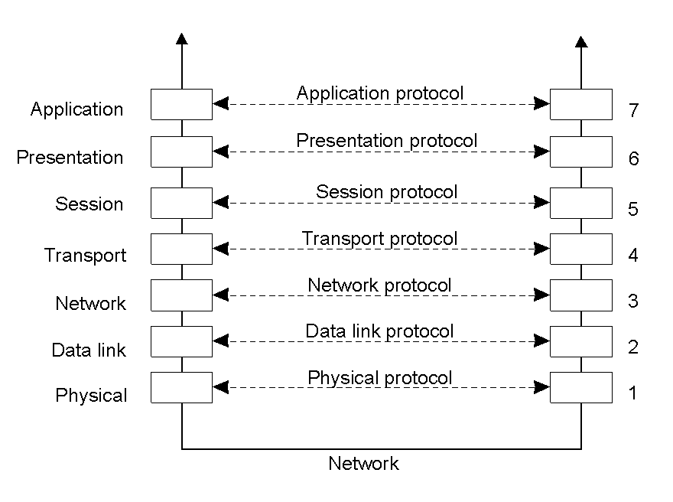
Explain the OSI reference model.
What’s different between TCP and UDP?
What is a DNS?
What is an RFC?
When could it make sense to use a proxy?
17
Practice for the final

Slide 18
What tool can we use to perform a DNS resolution?
What can you tell about 127.0.0.1?
What distribution of Linux focuses on security?
What are 3 applications of sniffing?
Explain how to use Ettercap to do a MITM.
18
Practice for the final

Slide 19
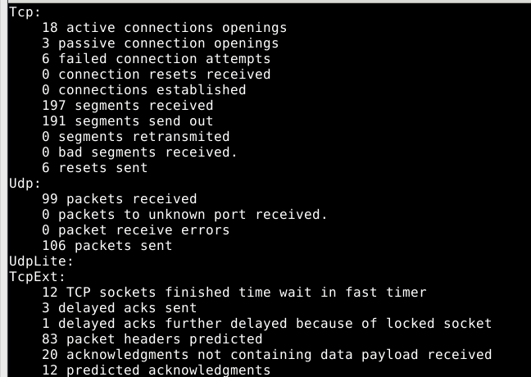
Explain all the tools that you would use, and roughly how, to monitor every day at midnight if there are more than 20 connections on TCP and warn the user if that’s the case.
netstat
cron
script
+
+
If you’re trying to play an online game but it’s not working well. You suspect it’s because communication with the server is bad. How can you check?
19
Practice for the final

Slide 20
Loops
20
Practice for the final

Slide 21
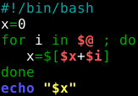

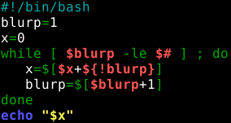
1) Assume that you just wrote that script in nano and saved the file as test.sh. Write everything you’d need to type in the shell to run it on an example of your choice.
2) What would ./test.sh 1 2 3 show?
3) What does this script do?
4) Write this using a for loop.
21
Practice for the final

Slide 22
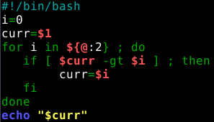
1) Assume that you have saved that file as test.sh and made it runnable. What would you write in the shell to run it on an example of your choice?
2) What does ./test.sh 4 2 1 5 0 6 show?
3) What does this do?
4) Why do we do ${@:2} instead of $@ ?
5) Write it using a while loop.
22
Practice for the final

Slide 23
1) Write a for loop that creates folders 1, 3, 5, ..., 17 and makes an empty ToDoFile in each one.
2) Do the same using a while loop.
3a) Write a script keepMakingFolders.sh. The first time you call it, it creates a folder phil1 and saves in a file that its current folder number is 1. Next time you call it, it reads that file to know what folder it was at, and continues from that. So the second time it makes phil2, third time it makes phil3, etc.
3b) Modify keepMakingFolders.sh so that it takes the number of folders as an argument. For example, ./keepMakingFolders.sh 5 should make the next 5 folders.
3c) Modify the version from 3b so that after creating the folders it also asks you whether you want the next batch. If you say Yes, yes, Y or y then it creates them.
23
Practice for the final

